Slide 1
Volunteer Workplace Health and Safety

Slide 2

What is Workplace Health and Safety?
Health Safety and Well Being Value
Our responsibilities:
As an employee/volunteer with the department we all have a Duty of Care to continue to perform WHS practises on a day to day basis and in emergency situations.
Duty of care to those around us (staff, students, volunteers, parents etc) within school boundaries and official school events (internal and external).
Duty of care to school facilities and equipment making sure it is used and maintained in a safe manor.
Notes:
Complete activity – what does this mean to you – your why
10 mins

Slide 3


Fire and Evacuation Procedures
Signal of Evacuation:
- Continuous sound of the ‘Whoop Whoop’ SIREN over PA Systems.
When signal occurs:
All students, staff, visitors and work personal are to evacuate immediately from all buildings and follow Emergency Procedures at the Assembly Areas.
Assembly area/s
Assembly Pt 1 : School Oval
Assembly Pt 2: Pizzey Park (Burleigh Bears Oval)
What to bring:
ALL staff MUST take KEYS
ALL TEACHING staff to take ORANGE FOLDERS for marking roll.

Slide 4
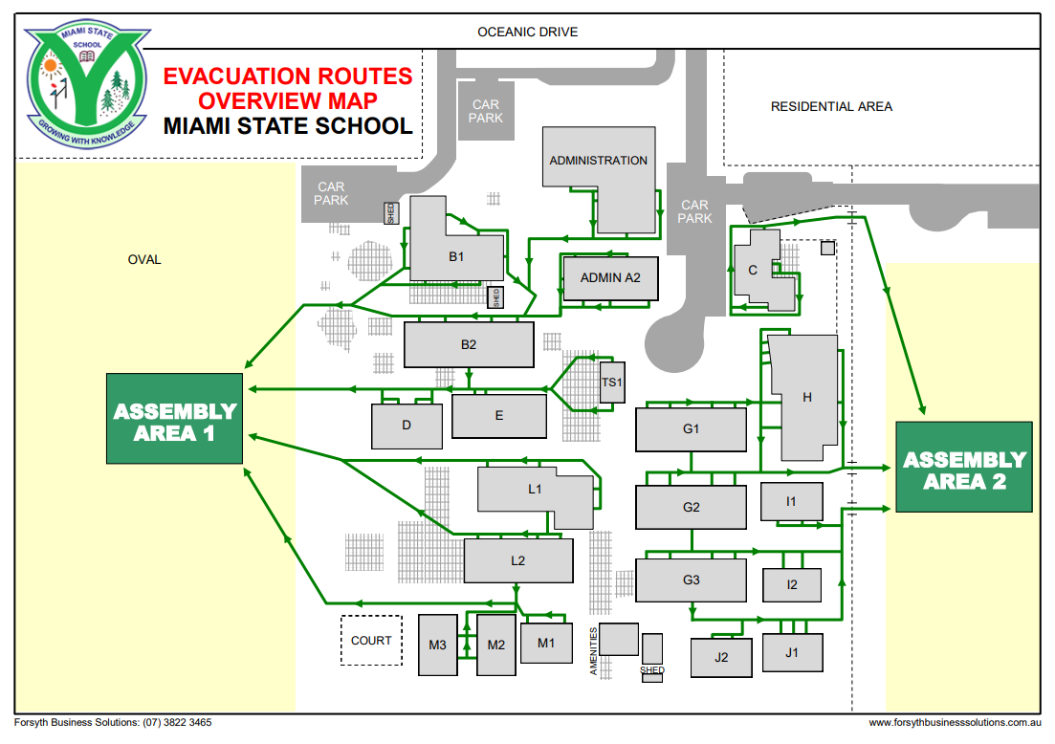
Evacuation Points
- Specific Evacuation Maps for Each building is located at exit doors.

Slide 5
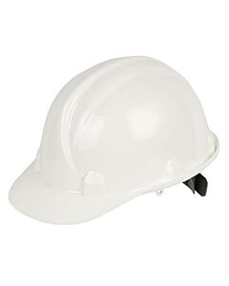

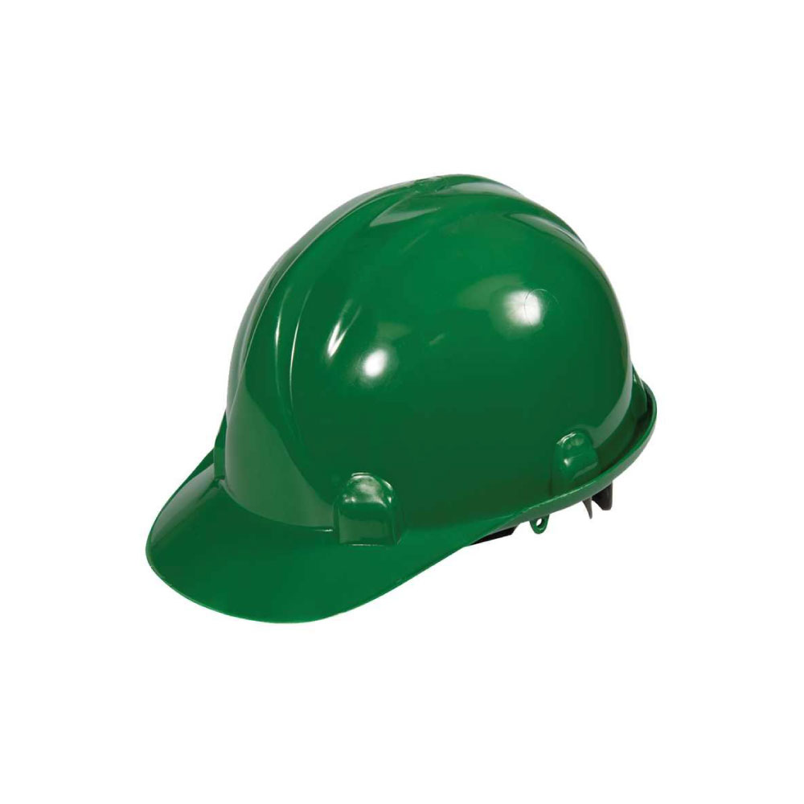
Roles of Evacuation Team
Role | Responsible Person | Duty | Identification
Evacuation Coordinator | Jemille - Principal | Talk with Emergency Services (front of school) | White Helmet
Chief Warden | Deputy/s Julia and Ben | account for all teachers account for all students | White Helmet
2nd in Charge | HOCs Kerrie and Kath Backup Assistance BM Jess | account for all teacher aides and support staff account for visitors account for volunteers and work experience visitors. | Red Helmet
Safety Manager and First Aid | Coach Amy | check all buildings are clear assist with first aid | Green Helmet

Slide 6
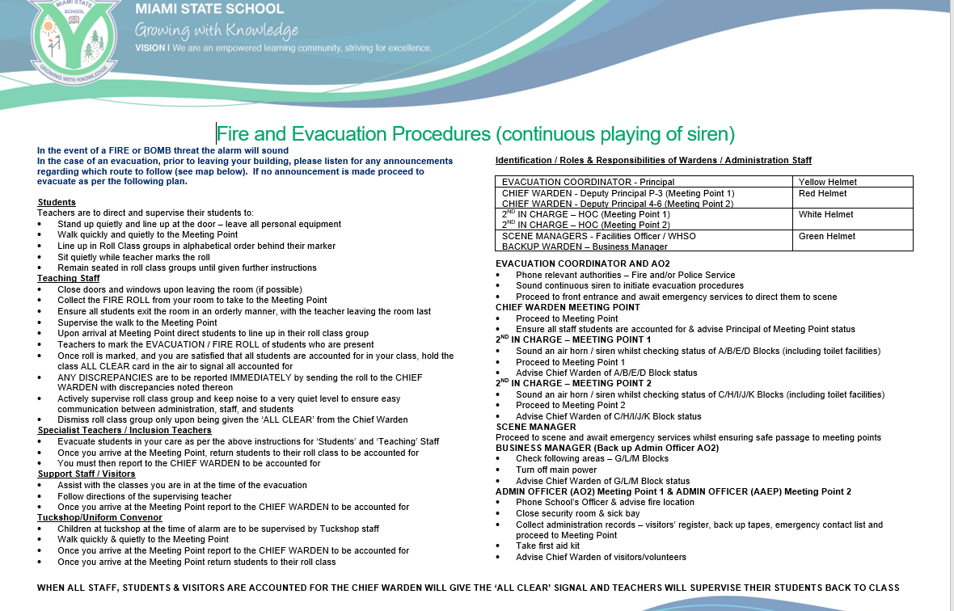
Additional Role Information
Can be found located at:
building exit doors
(with evacuation map and orange folders)
SharePoint (Document Library)

Slide 7
Fire and Evacuation Procedures
Teaching Staff
Move | Move yourself and students to the nearest evacuation point (oval or park). Bring your ROLLS and KEYS.
Mark | Go to your year level mark and mark your roll.
Report | Report missing students or additional students to Chief Warden.
Hold | Hold up your roll and wait in your position until “All Clear” from Chief Warden.
Auxiliary Staff + Admin + Visitors
Move | Move to the nearest evacuation point (oval or park). All staff to bring KEYS
Mark | Go to your mark near 2nd in Charge and line up.
Report | Report to 2nd in Charge your presence (roll).
Hold | Hold in your line position until “All Clear” from Chief Warden.

Slide 8

Lockdown Procedures
Signal for Lockdown:
Listen for song ‘Van Morrison-Days like These’ over the PA system (internal and external).
When signal occurs:
All students, staff, visitors and work personal are to lockdown in buildings and follow Lockdown procedures.
What must happen:
All buildings and facilities must be secured (locked).
All individuals need to be ‘hidden from sight’.
All staff must CALL OFFICE to be accounted for.
Teachers MUST account for students by MARKING ROLL (Orange Folder).

Slide 9
Lockdown Procedures
Teaching + Auxiliary Staff
Move | Move students and yourself to the nearest safe place that is ‘out of sight’
Lock | Lock all external and internal doors/windows/louvers that are within reach
Switch | Switch off all lights (room and protectors)
Call 820 830 840 55954820 (from mobile) | Mark roll (teaching staff only) and call admin to account for all individuals in your room. When calling: -state your name - students/accounted or missing - name of staff/students who are in the room with you
What must happen:
All buildings and facilities must be secured (locked).
All individuals need to be ‘hidden from sight’.
All staff must CALL OFFICE to be accounted for.
Teachers MUST account for students by MARKING ROLL (Orange Folder).

Slide 10


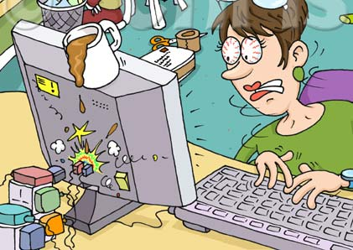

Safe Use of Equipment and Resources
Use equipment and resources according to recommended instructions for use
Only approved chemicals and equipment to be brought into the school and used
Enclosed hot beverage cups to be used when walking through the school or in classrooms
Be aware of back care when lifting heavy items – use trolleys and lifts
Refer to CARA and complete Risk Assessments
Notes:
Complete activity – what does this mean to you – your why
10 mins

